Slide 1
Chapter 1
Basic Structure of Computers

Slide 2
Chapter Outline
Computer types, structure, and operation
Instructions and programs
Numbers, arithmetic operations, and characters
Performance issues
Historical perspective

Slide 3
Types of computers
Embedded computers
Personal computers
Servers and Enterprise systems
Supercomputers and Grid computers
“Cloud” computing

Slide 4
Functional units
Input: Typical devices – keyboard, touchpad,
mouse, microphone, camera,
communication lines, the Internet
Output: Typical devices – text and graphics
displays, printers

Slide 5
Functional units
Primary memory (also called Main memory)
semiconductor bit cells, organized into words
of typically 32 bits
a 32-bit word contains four 8-bit bytes
a personal computer memory might hold
4 Gigabytes or more (1 Gbyte = 2³² bytes)
programs and their data must be in this memory to be executed

Slide 6
Functional units
Secondary memory
magnetic and optical disks, flash mem. devices
these devices are store program and data files
magnetic disks store 500 Gigabytes or more

Slide 7
Functional units
Cache memory
an adjunct to the main memory, fabricated
on the processor chip
much smaller and faster than the main
memory
holds sections of the program and data
currently being executed

Slide 8
Functional units
Processor
logic circuits for performing arithmetic and
logic operations on word-size data operands
timing and control circuits for fetching
program instructions and data from
memory, one after another
registers (typically 16 or 32), each of which
hold one word of operand data

Slide 9
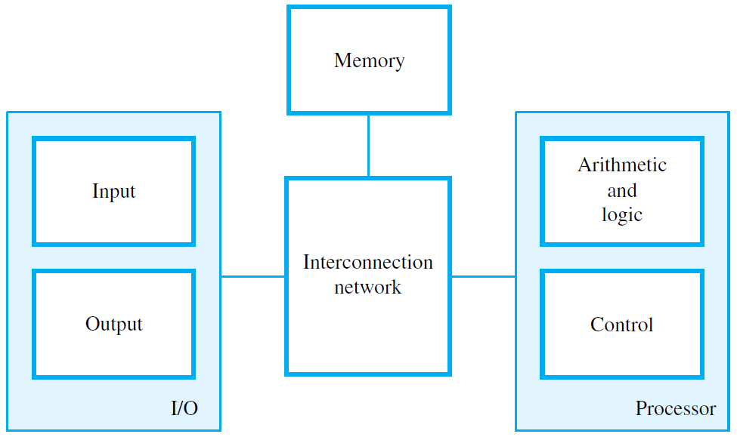

Slide 10
Instructions and Programs
An instruction specifies an operation and
the locations of its data operands
A 32-bit word typically holds one encoded
instruction
A sequence of instructions, executed one
after another, constitutes a program
Both a program and its data are stored in
the main memory

Slide 11
Instruction types
Three basic instruction types:
Load - Read a data operand from memory or
an input device into the processor
Store - Write a data operand from a processor
register to memory or an output device
Operate - Perform an arithmetic or logic
operation on data operands in processor
registers

Slide 12
Example program
A, B, and C, are labels representing memory word
addresses; Ri are processor registers
A program for the calculation
C = A + B
is:
Load R2, A
Load R3, B
Add R4, R2, R3
Store R4, C

Slide 13
Processor components
The program counter (PC) register holds the
memory address of the current instruction
The instruction register (IR) holds the current
instruction
General-purpose registers hold data and
addresses
Control circuits and the arithmetic and logic unit (ALU) fetch and execute instructions

Slide 14
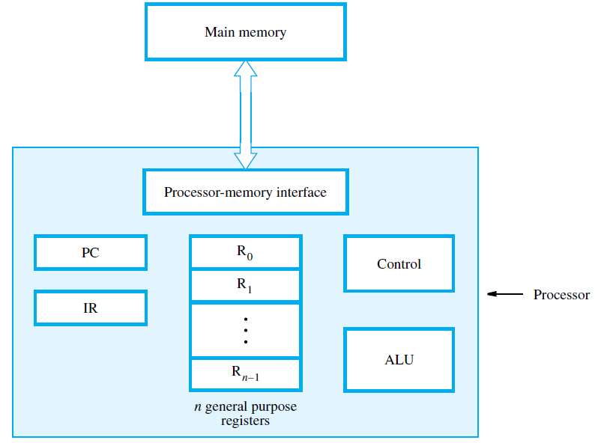

Slide 15
Fetching and executing instructions
Example: Load R2, LOC
The processor control circuits do the following:
Send address in PC to memory; issue Read
Load instruction from memory into IR
Increment PC to point to next instruction
Send address LOC to memory; issue Read
Load word from memory into register R2

Slide 16
Handling I/O devices
An application program can:
Read data (such as a keyboard character)
from an input device
Write data (such as letter character)
to an output display screen
Sense the readiness of an input or output (I/O) device to perform a transfer

Slide 17
Interrupts
A device (such as an alarm indicator) can raise
an interrupt signal to cause a dedicated
service program to be executed
The interrupt signal causes the processor to
suspend the current program and execute an
interrupt-service program

Slide 18
Numbers
A 32-bit integer in positional binary notation has
its bits labeled as:
B = b₃₁ b₃₀ . . . b₁ b₀
If bit b_{i} = 1, then 2^{i} is added into the sum that determines the value of B

Slide 19
Numbers
For signed integers, the leftmost bit is used
to indicate the sign:
0 for positive
1 for negative
There are three ways to represent signed integers:
Sign and magnitude
1’s complement
2’s complement

Slide 20
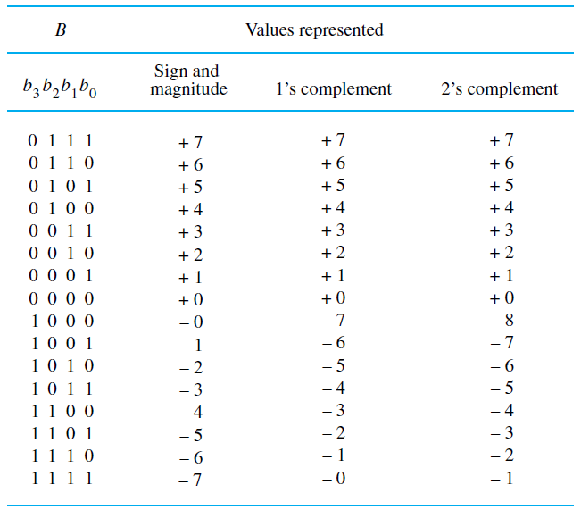

Slide 21
2’s-complement integers
2’s-complement representation is used in
current computers
Consider a four-bit signed integer example,
where the value +5 is represented as:
0 1 0 1
To form the value -5, complement all bits of
0 1 0 1 to obtain 1 0 1 0
and then add 1 to obtain
1 0 1 1

Slide 22
Addition
Two examples of adding four-bit numbers:
0 0 0 1 +1 0 1 0 0 +4
+ 0 1 0₁1 + +5 + 1 0 1 0 + -6
-------------- -------- ------------- ------
0 1 1 0 +6 1 1 1 0 -2

Slide 23
Subtraction
Form the 2’s-complement of the subtrahend
and then perform normal addition
1 1 1 0 -2 1 1 1 0
- 1 0 1 1 - -5 + ₁ 0₁1 0 0₁
------------ ------ --------------
+3 0 0 1 1

Slide 24
Overflow
Two examples of overflow; that is, when the answer does not fit in the number range
0 1 1 0 +6 1 1 1 0 -2
+ 0₁1 0 0 + +4 ₁1 0 0 1 + -7
------------ ------ ---------- ------
1 0 1 0 +10 0 1 1 1 -9

Slide 25
Sign extension
Replicate the sign bit to extend
4-bit signed integers to 8-bit signed integers
0 1 0 1 0 0 0 0 0 1 0 1
1 1 1 0 1 1 1 1 1 1 1 0

Slide 26
Character encoding
American Standard Code for Information
Interchange (ASCII)
uses 7-bit codes
Examples:
character code
A 1 0 0 0 0 0 1
7 0 1 1 0 1 1 1
+ 0 1 0 1 0 1 1

Slide 27
Floating-point numbers
32-bit signed numbers have a limited range
32-bit integers (with binary point fixed at the
right end) have magnitude up to approx. 10¹⁰
Fractions (with binary point fixed just after
sign bit) have magnitude down to approx. 10⁻¹⁰

Slide 28
Floating-point numbers
A larger range can be obtained by letting the
binary point “float” to the left or right
< ……………..1 1 0 1 0 1……………… >
Arithmetic unit operations automatically adjust
the binary point as computation proceeds

Slide 29
Floating-point numbers
A floating-point number can be represented in
a 32-bit word as follows:
1 bit for the sign of the number
8 bits for a signed exponent to a base of 2
23 significant bits in the form 1.XX….X
The value represented is:
± 1.XX….X × 2^{exp}

Slide 30
Performance
How quickly can a program be executed ?
Some factors:
Speed of electronic circuits in the processor
Access times to the cache and main memory
Design of the instruction set
Number of operations that can be done at the
same time (parallelism)

Slide 31
Parallelism
Multiple processors, called cores, can be
fabricated on a single VLSI chip
The cores can execute different parts of a program at the same time
A large number of multi-core processors with
multiple caches and memory modules
can be organized into a multiprocessor
system to execute programs at the same time

Slide 32
Historical perspective
Up to the 1940s:
mechanical devices,
electromechanical relay devices
First generation computers, 1945-1955:
vacuum tube circuits,
magnetic core memories

Slide 33
Historical perspective
Second generation, 1955-1965:
transistor circuitry, magnetic disk data storage
Third generation, 1965-1975:
integrated circuits for processors and memory
Fourth generation, 1975-present:
microprocessors on a single VLSI chip,
personal computers, embedded systems,
very high performance multiprocessors

